Slide 1
Operators in Python

Slide 2
Python divides the operators into the following seven groups:
Arithmetic operators
Assignment operators
Comparison operators
Logical operators
Identity operators
Membership operators
Bitwise operators

Slide 3
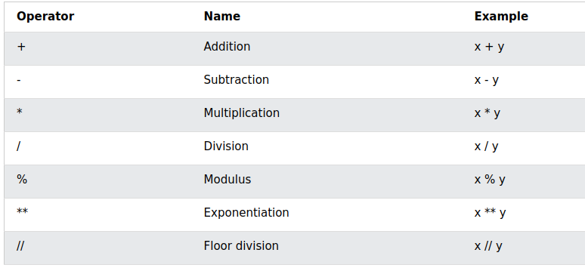
Arithmetic operators

Slide 4
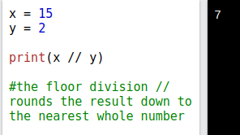
Floor Division

Slide 5
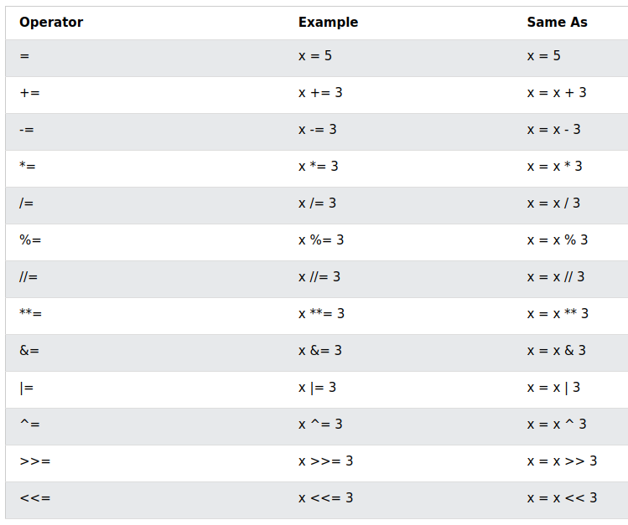
Assignment Operators
X+=5: shorthand expression for x=x+5
Python does not have ++ (as in i++) operator.
If you want to increment a variable:
x += 1

Slide 6
Assignment Operator (Problem)
What is the output of this program?
x = 5
y = 10
x = y
print(x)
print(y)

Slide 7
Assignment Operator (Solution)
What is the output of this program?
x = 5 # x is the variable name. Explicit value being passed is 5.
y = 10 # y is the variable name. Explicit value being passed is 10.
x = y # Variable which is taking the value is on the left. X is taking the value. And value being passed is 10 through y.
print(x)
print(y)

Slide 8
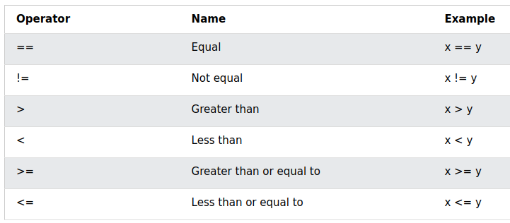
Comparison Operators

Slide 9
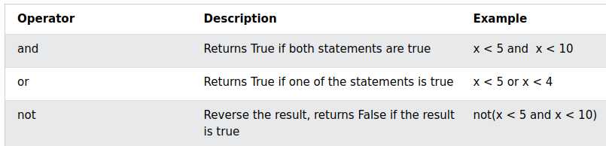
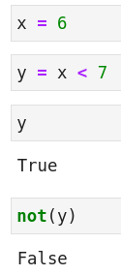
Logical Operators
“and” in C++ is: &&
“or” in C++ is: ||
“and” checks both the conditions. It returns true only if both of them are true.
“or” checks both the conditions. It returns true if either of the two conditions are true.

Slide 10
Problem
What will be the output of:
x = 0
print(x<5 and x<10)
x = 6
print(x<5 and x<10)
X = 0
print(x<5 or x<4)
X = 6
print(x<5 or x<4)

Slide 11
Solution
What will be the output of:
x = 0
print(x<5 and x<10) # True and True
x = 6
print(x<5 and x<10) # False and True
X = 0
print(x<5 or x<4) # True
X = 6
print(x<5 or x<4) # False

Slide 12
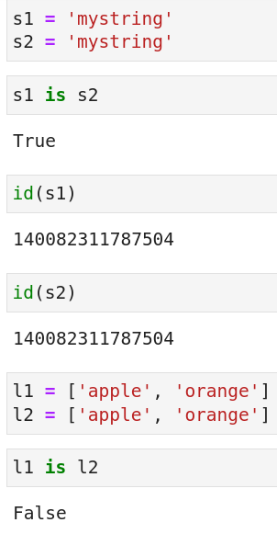
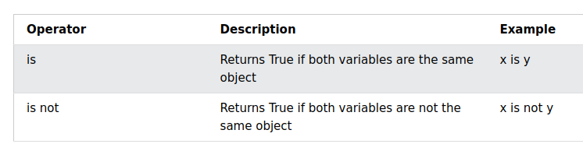
Identity Operators

Slide 13
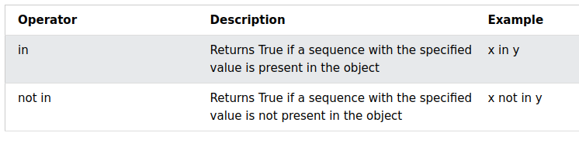
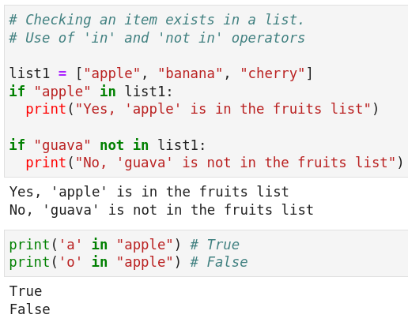
Membership Operators

Slide 14
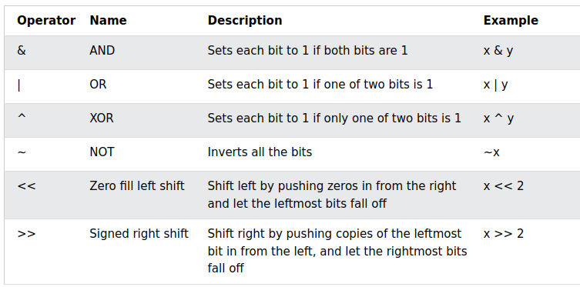
Bitwise Operators

